Slide 1
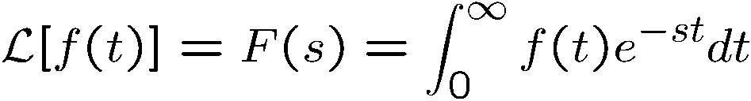


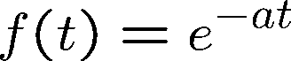
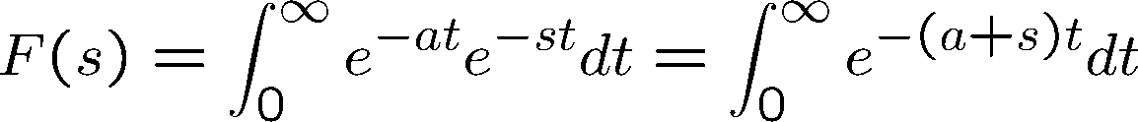
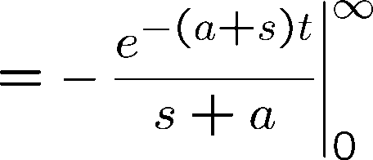
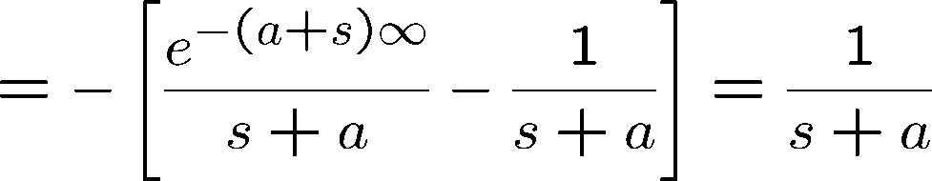
Laplace Transform
Let f(t) be a function of time t, such that f(t) = 0, for t < 0, then
is the Laplace transform of f(t). s is a complex variable
Example:

Slide 2

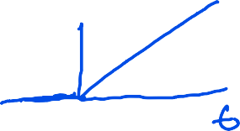

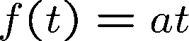
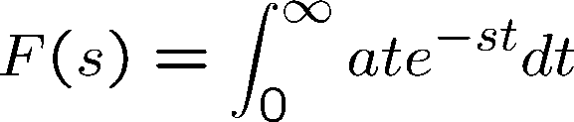
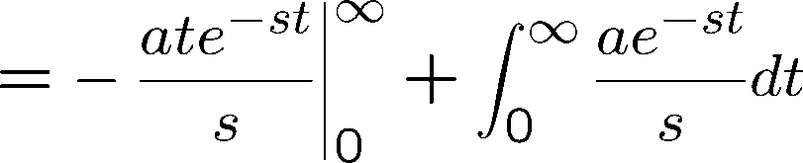
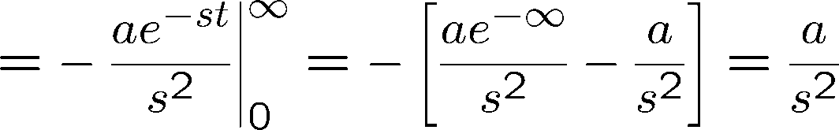




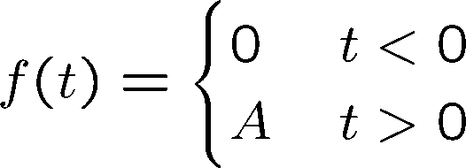



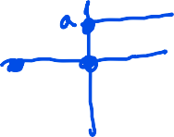


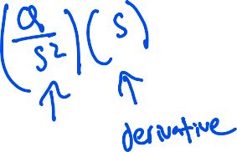

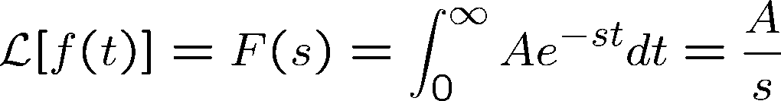
Laplace Transform
Example:
Example (Step function):

Slide 3
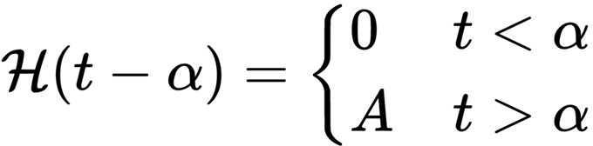
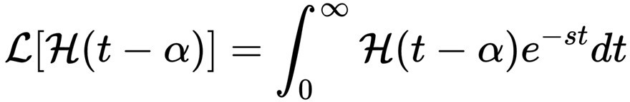
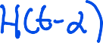
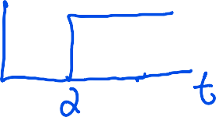
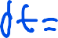

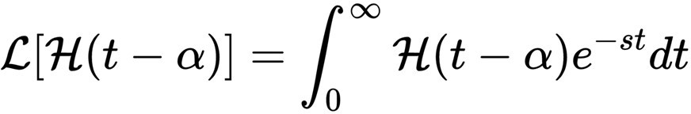
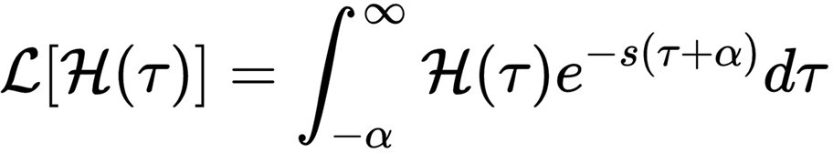
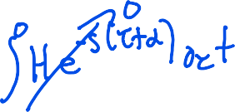

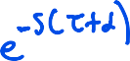

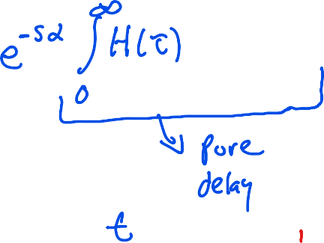

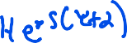
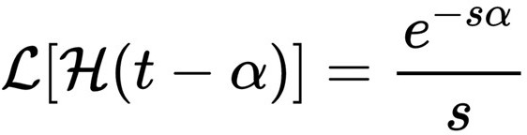

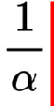
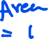



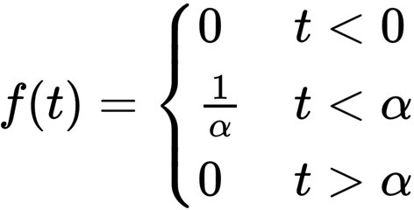

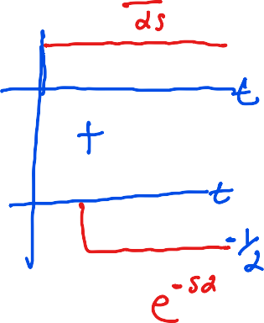
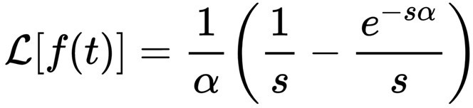










Laplace Transform (Impulse Function)
Example (Heaviside Step function):
Define
Define a pulse function as:
In the limit as
goes to zero, the Laplace transform goes to unity.

Slide 4


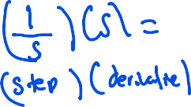


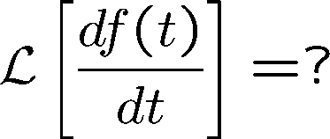
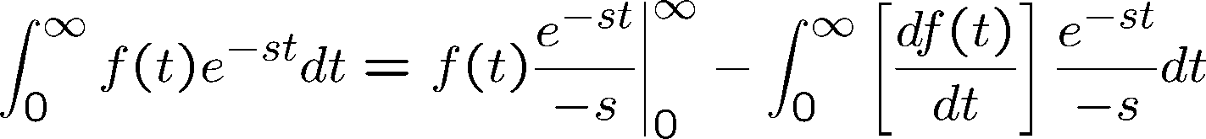
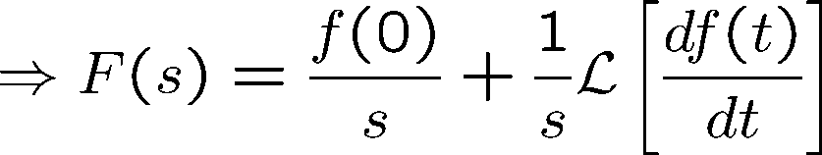
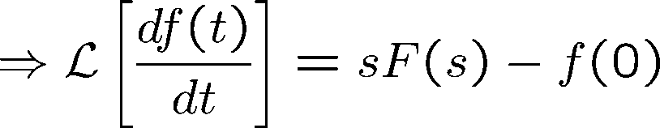
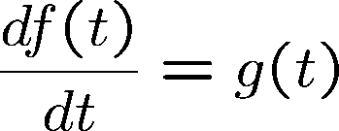
Laplace Transform of the Derivative of a Function
Consider

Slide 5

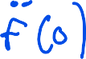

Laplace Transform of the Derivative of a Function
Similarly

Slide 6
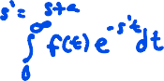
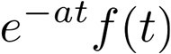



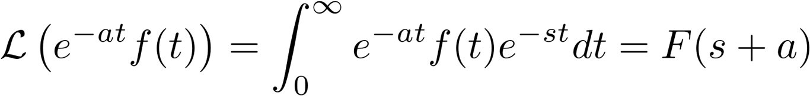
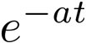
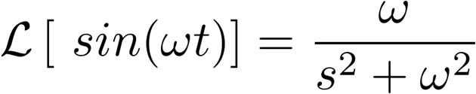
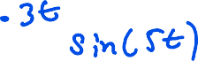

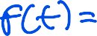

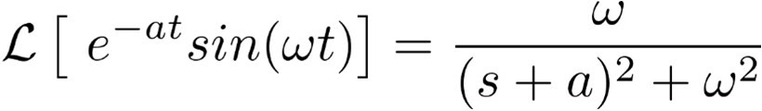

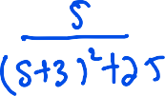


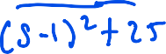
Laplace Transform of a Function multiplied by e^{-at}
Let f(t) be Laplace transformable, its Laplace transform being F(s), then the Laplace transform of
We see that multiplication of f(t) by by (s+a) in the Laplace Transform
has the effect of replacing s
Example:

Slide 7
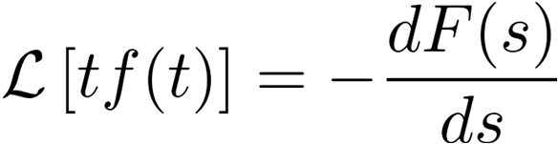
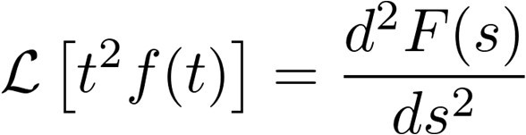











Complex-Differentiation Theorem
If f(t) is Laplace transformable, then
In general
Example:

Slide 8





Final and Initial Value Theorem
Final Value Theorem:
If f(t) and are Laplace transformable, if F(s) is the Laplace transform of
f(t), and if
exists, then
Consider
Since

Slide 9




Final and Initial Value Theorem
we have
Thus,
Final Value theorem is applicable only if
F(s) has no roots of the denominator (poles) in the complex right half plane
F(s) should have no poles on the imaginary axis, except at most one pole at s=0
Initial Value Theorem:
If f(t) and are Laplace transformable, if F(s) is the Laplace transform of
f(t), and if
exists, then

Slide 10
















Inverse Laplace Transform
Example: (Distinct Poles)
We can write
where a_{k} – residue at the pole s=p_{k.} Example:

Slide 11



Inverse Laplace Transform
therefore,
Example:
This has to be written as

Slide 12













Inverse Laplace Transform
therefore,
Example: (Multiple Poles)

Slide 13

































Inverse Laplace Transform
Consider,
Similiarly

Slide 14




Solving Differential Equations
Consider the differential equation
Define
Therefore

Slide 15























Solving Differential Equations
Consider the differential equation
Laplace transformation leads to:
Therefore

Slide 16


Transfer Function
The transfer function of a linear time-invariant system is defined to be the ratio of the Laplace transform of the output to the Laplace transform of the input under the assumption of zero initial conditions.
Consider the differential equation:
Where y is the output of the system and u is the input. The transfer function is given by taking the Laplace transform of the above equation:
The Transfer function is a property of the system itself and not a function of the input function
Transfer function of many physically different systems can be identical. eg. Spring-mass-dashpot and RLC circuit.

Slide 17







Example
For the spring-mass dashpot system
u
k
m
c
y
Force balance leads to the free body diagram
m
Assuming the initial conditions to be zero, and taking the Laplace transform of the above equation leads to:

Slide 18









Example
For the R-L-C system
L
R
Kirchoff’s law gives us
C
Assuming the initial conditions to be zero, and taking the Laplace transform of the above equation leads to:
If e_{i} and e_{o} are the inputs and outputs respectively, we have

Slide 19







Block Diagrams
A block diagram of a system is a pictorial representative of the function performance by each component and of the flow of signals. The block is a symbol for the mathematical operation on the input signal to the block.
Transfer function G(s)
Error Detector: The error detector produces a signal which is the difference between the reference input and the feedback signal of the control system.

Slide 20

Block Diagram (Closed Loop)
Summing point
Transfer function G(s)
Branch point
When the output signal is fed back to the summing point for comparison with the input, it is necessary to convert the form of the output signal to that of the input signal. This is accomplished by the feedback element whose transfer function is H(S)
Transfer function G(s)
H(s)

Slide 21




Block Diagram (Closed Loop)
The ratio of the feedback signal to the actuating error signal E(s) is called the open-loop transfer function. That is
The ratio of the output X(s) to the actuating signal E(s) is called the feedforward transfer function:
We can see from the closed loop block diagram:
Eliminating E(s) from the above equations, we have
This is called the closed loop transfer function

Slide 22








Block Diagram Reduction
D(s)
C(s)
F(s)
G(s)
Y(s)
H(s)

Slide 23



Block Diagram Reduction

Slide 24





Block Diagram Reduction (Superposition)
Assume D = 0,
C(s)
F(s)
G(s)
Y(s)
H(s)
Assume R = 0,
D(s)
G(s)
Y(s)
C(s)
-H(s)
Note: Positive Feedback)

Slide 25











First Order System
Transfer function:
Response to a unit step input is:
Partial Fraction Expansion leads to:
Inverse Laplace transform leads to:

Slide 26







First Order System
At t = T, the output is:
T represents the time required for the system response to reach 63.2% of the final value. T is referred to as the Time Constant of the system
The slope of the system response at time = 0 is:
Response of the first order system to a unit ramp is:
Tracking error as time tends to infinity is:

Slide 27



First Order System
Half-Life: Time it takes for a quantity to reduce to half its initial value. For this example, velocity to decrease to half of its initial value.
The log of the evolving output v(t) is given by the equation:
which can be rewritten as the equation:
Have life is the time required for the output to reach half its initial value, therefore:

Slide 28











Second Order System
Transfer function:
Response to a unit step input is:

Slide 29





S-plane representation
Laplace transform with zero initial conditions leads to:

Slide 30

Transient Response
In analyzing and designing control systems, we must have a basis of comparison of performance of various control systems. This basis may be set up by specifying particular test input signals and by comparing the response of various systems to these input signals. Typical test signals: Step function, ramp function, impulse function, sinusoid function.
The time response of a control system consists of two parts: the transient and the steady-state response. Transient response corresponds to the behavior of the system from the initial state to the final state. By steady state, we mean the manner in which the system output behaves as time approaches infinity.
For a step input, the transient response can be characterized by: Delay time t_{d}: time to reach half the final value for the first time.
Rise time t_{r}: time required for the response to rise from 10% to 90% for overdamped systems, and from 0% to 100% for underdamped systems
Peak time t_{p}: time required to reach the first peak of the overshoot Percent Overshoot M_{p}:
Settling time t_{s}: time required for the response curve to reach and stay within 2% or 5% of the final value. Is a function of the largest time constant of the control system.

Slide 31






Transient Response

Slide 32




Transient Response
For a step input, the transient response can be characterized by:
Rise time t_{r}: time required for the response to rise from 10% to 90% for overdamped systems, and from 0% to 100% for underdamped systems
Since
Thus, the rise time is:

Slide 33





Transient Response
For a step input, the transient response can be characterized by:
Peak time t_{p}: time required to reach the first peak of the overshoot
Thus, the peak time is:

Slide 34

Transient Response
For a step input, the transient response can be characterized by:
Percent Overshoot M_{p}:
Maximum overshoot is function of damping ratio only.

Slide 35



Transient Response
For a step input, the transient response can be characterized by:
Settling time t_{s}:
2% Settling time:
2 % Settling Time
5% Settling time:
5 % Settling Time

Slide 36

Routh Stability Criterion
Consider the closed loop transfer function of the form:
where a’s and b’s are constant and where m< n.
If any of the coefficients are zero or negative in the presence of at least one positive coefficient, there is a root or roots which are imaginary or which have positive real parts.
If all the coefficients are positive, arrange the coefficients of the polynomial in rows and columns according to the pattern:

Slide 37






Routh Stability Criterion
_{s}n | a₀ | a₂ | a₄ | a₆ | …
_{s}n-1 | a₁ | a₃ | a₅ | a₇ | …
_{s}n-2 | b₁ | b₂ | b₃ | b₄ | …
_{s}n-3 | c₁ | c₂ | c₃ | c₄ | …
_{s}n-4 | d₁ | d₂ | d₃ | d₄ | …
… | … | … | … | … | …
_{s}2 | e₁ | e₂
_{s}1 | f₁
_{s}0 | g₁
…
…

Slide 38


Routh Stability Criterion
Routh’s stability criterion states that the number of roots of the system G(s) with positive real parts is equal to the number of changes in the sign of the coefficients of the first column of the array.
The necessary and sufficient condition that all poles of G(s) lie in the left half plane is that all the coefficient of the denominator of G(s) be positive and all terms in the first column of the array have positive signs.
Special Case:
If a first-column term in any row is zero, but the remaining terms are not zero or there is no remaining term, then the zero term is replaced by a very small positive number eand the rest of the array is evaluated.
If the sign of the coefficient above the zero is the same as that below it, it indicates that there are a pair of poles on the imaginary axis.

Slide 39


Routh Stability Criterion
Special Case:
If all the coefficients in any derived row are zero, it indicates that there are roots of equal magnitude lying radially opposite in the s-plane, eg. two real roots with equal magnitudes and opposite signs and/or two conjugate imaginary roots
In such a case, the evaluation of the rest of the array can be continued by forming an auxiliary polynomial with the coefficient of the last row and the coefficients of the derivative of this polynomial in the next row

Slide 40



Routh Stability Criterion
The closed loop system can be represented as:
The Routh table for the closed loop system is:
The second and fifth row indicate that :

Slide 41


Routh Stability Criterion
The third and fourth row requires:
The requirement:
Results in a stable controller for all gains which satisfy the inequality constraints:

Slide 42
Routh Stability Criterion (Relative Stability)
Relative Stability: The Routh criteria is a tools which provides a binary answer to the question of absolute stability, i.e., whether the system is stable or not.
Relative stability permits comparing two system and gauging which system is relatively more stable. A simple characterization of relative stability is the distance of the pole with the largest real value from the imaginary axis. Closer the pole is to the imaginary axis, smaller is its relative stability. Once can use the Routh Criteria to determine the number of poles that lie to the right of a shifted imaginary axis.
Substitute s = z − σ (σ = constant) into the characteristic equation of the system and rewrite the characteristic equation in terms of z. Applying the Routh Criteria to new polynomial in z permits one to determine the number of poles to the right of the vertical line s = −σ. Thus, this test reveals the number of roots which lie to the right of the vertical line s = −σ

Slide 43

Static Error Coefficients
Consider the open loop transfer function:
which includes N poles at the origin of the s-plane.
A system is called type 0, type 1, type 2,…., if N = 0,1,2,…, respectively.
The transfer function of the closed loop system:
R(s) +
E(s)
C(s)
G(s)
-
H(s)

Slide 44


Static Error Coefficients
and the error transfer function can be calculated as:
The steady state error can be calculated as:

Slide 45


Static Position Error Coefficients K_{p}
The steady-state error of a system subject to an unit step input is:
The static position error coefficient K_{p} is defined as:
The steady state error is given by the equation:

Slide 46


Root Locus
The locus of the roots of the closed loop system as a function of a system parameter, as it is varied from 0 to infinity results in the moniker, Root-Locus.
The root-locus permits determination of the closed-loop poles given the open-loop poles and zeros of the system.
For the system:
R(s) +
E(s)
C(s)
G(s)
-
H(s)
the closed loop transfer function is:
The characteristic equation:

Slide 47


Root Locus
when solved results in the poles of the closed-loop system. The characteristic equation can be written as:
Since G(s)H(s) is a complex quantity, the equation can be rewritten as:
Angle criterion:
Magnitude criterion:
The values of s which satisfy the magnitude and angle criterion lie on the root locus.
Solving the angle criterion alone results in the root-locus. The magnitude criterion locates the closed loop poles on the locus.

Slide 48


Root Locus
Often the open-loop transfer function G(s)H(s) involved a gain parameter K, resulting in the characteristic equation:
Then the root-loci are the loci of the closed loop poles as K is varied from 0 to infinity.
To sketch the root-loci, we require the poles and zeros of the open-loop system. Now, the angle and magnitude criterion can be schematically represented as, for the system:

Slide 49



Root Locus
Im
Im
s
A₂
q₂
q₂
X
X
-p₂
-p₂ A₂
A₁
s
A₄
B₁
A₃
A₄
q
f
q
A
1
q
4
1
1
q
f
B₁
1
X
-p₄
-z
X
Re
X
-p₄
4
-z
1
X
Re
1
-p₁
1
-p₁
A₃
q₃
-p₃
q₃
X
X
-p₃

Slide 50

Root Locus (Example)
Asymptotes of the root-loci as s tends to infinity can be determined as follows: Select a test point far from the origin:
and the angle criterion is:
or, the angle of the asymptotes are:
For this example, they are 60º, -60º, -180º.
To draw the asymptotes, we must find the point where they intersect the real-axis. Since, the transfer function for a test point s far from the origin permits us to approximate the transfer function as:

Slide 51







Root Locus (Example)
The angle criterion for the approximated system is:
Substituting
, we have
Taking the tangent of both sides, we have:
which can be written as:

Slide 52



Root Locus (Example)
The three equations result is three straight lines shown below, which are the asymptotes, which meet at the point s=-1. Thus, the abscissa of the intersection of the asymptotes and the real-axis is determined by setting the denominator of the approximated transfer function to zero and solving for s.
Im
-1
Re

Slide 53


Root Locus (Example)
The root loci starting from 0 and -1, break away from the real axis as K is increased. The breakaway point corresponds to a point in the s-plane where multiple roots of the characteristic equation occur.
Representing the characteristic equation as:
We know that f(s) has multiple roots at s = s₁, if
Which when substituted into Equation 1, gives us:

Slide 54



Root Locus (Example)
Consider the equation:
which can be rewritten as:
The derivative of K with respect to s gives:
Which when set to zero gives the same constraint as before:
Therefore, the breakaway point can be determined by setting:

Slide 55




Root Locus (Example)
For the current example, we have:
The derivative of K with respect to s gives:
or
Since the breakaway point must lie between 0 and -1, s = -0.4226 corresponds to the actual breakaway point and the corresponding gain is:
The gain corresponding to the point s = -1.5774 is: Which belongs to the complementary root-locus.

Slide 56

Root Locus (Example)
Locations where the Root-loci crosses the imaginary axis can be determined by substituting s = jwin the characteristic equation as solving for K and s.
For the current example, we have
or
Equating the real and imaginary parts to zero, we have
which results in the solutions:
Thus, the root locus cross the imaginary axis at

Slide 57




Root Locus (Example)
Consider the system with an open-loop transfer function:
which has open loop poles at:
and a zero at
From the rule about existence of root-loci on the real axis, it is clear that to the left of the point s=-2, the entire real axis is part of the root-loci.
Since root-loci start at open-loop poles and end at open-loop zeros, we know that the two root-loci which start at the complex open loop poles should break in on the real axis and one of the root-loci should move towards s = -2, and the other towards
How does the root locus depart from
?

Slide 58


Root Locus (Example)
Consider a test point s in the vicinity of the complex open-loop pole p₁:
s
Im
q₁
X
-p₁
f₁
-z₁
Re
q₂
X
-p₂
The angular contribution of the pole p₂ and the zero z₁ to the test point s can be considered to be the same as the angle made by the lines connecting the pole p₂ and zero z₁ to the pole p₁ (if the test point is close to p₁).
Then, the angle of departure t1 is given by the angle criterion:

Slide 59



Root Locus (sketching rules)
Rule 1: Root locus is symmetric about the real axis
roots of characteristic equations are either real or complex conjugates
Can draw upper half plane only, although typically full s-plane loci are sketched
Rule 2: Each branch of the root locus originates at the open-loop pole with k=0, and terminates either at an open-loop zero or at infinity as k tends to infinity.
Characteristic Equation:
When k=0, poles at:
which are open-loop poles
Rewrite Characteristic Equation:
When k-> infinity, poles at: which are open-loop zeros
-m branches of the root loci terminate at open-loop zeros
- remaining (n-m) branches go to infinity along asymptotes as k-> infinity

Slide 60



Root Locus (sketching rules)
Rule 3: A point on the real axis lies on a locus if number of open-loop poles plus zeros on the real axis to the right of this point are odd.
Rule 4: The (n-m) branches of the root loci which tend to infinity do so along straight line asymptotes whose angles are:
Rule 5: The asymptotes cross the real axis at a point given by:

Slide 61
Root Locus (sketching rules)
Rule 6: Break points (points at which multiple roots of the characteristic equation occur) of root locus are solutions of dk/ds = 0.
Rule 7: The angle of departure from an open-loop pole is given by:
where fis the net angle contribution at the pole of all other open-loop poles and zeros. Similarly, the angle of arrival at an open-loop zero is given by:
where fis the net angle contribution at the pole of all other open-loop poles and zeros.
Angle of departure from real open-loop pole or angle of arrival at real open-loop zero is always 0 or p.
Rule 8: The points at which branches cross the imaginary axis can be determined by letting s=jwin the characteristic equation.

Slide 62


Dominant Poles
The “slowest poles” of a system (those closest to the imaginary axis in the s-plane) give rise to the longest lasting terms in the transient response of the system.
If a pole or set of poles are very slow compared to others in the transfer function, then they generally dominate the transient response and are referred to as the “Dominant Poles”.
Example:
The step response appears like a first order system response since the pole at s=-0.6 is the dominant pole.

Slide 63



Frequency Response Method
Transfer function:
For a stable system, the real parts of s_{i} lie in the left half of the complex plane. The response of the system to a sinusoidal input of amplitude X, is:
Where
and are complex conjugate constants and b_{i} are constants.

Slide 64






Bode Diagram
The complex quantity G(jw) can be represented as:
where
Thus, the transfer function can be represented by two plots: one of the magnitude of G(jw) vs. frequency and jvs frequency.
By plotting the logarithmic value of the magnitude of G(jw), multiplication operations are replaced by additions. This is the motivation for plotting
(decibels) vs. frequency which helps is rapidly plotting asymptotic approximation of the magnitude plot.
The basic factors which occur in a transfer function are:
-gain K
-Integral and derivative factor
-First order factors
-quadratic factors

Slide 65

Bode Diagram
Gain K: K is a real number and is not a function of frequency, so the magnitude plot does not change with frequency. Moreover, since the imaginary part of K is zero, the phase is zero for all frequency.
(NOTE: the matlab command to determine the db is 20*log10(K))

Slide 66



Bode Diagram
Integral factor : The magnitude of an integrator transfer function in db is:
The phase of an integrator transfer function is:
The magnitude for w= 1 is 0 The magnitude for w= 10 is -20 The magnitude for w= 100 is -40
It is clear if the magnitude if plotted on a semi-log graph, the magnitude plot is linear.

Slide 67


Bode Diagram
Derivative factor : The magnitude of an derivative transfer function in db is:
The phase of an differentiator transfer function is:
The magnitude for w= 1 is 0 The magnitude for w= 10 is 20 The magnitude for w= 100 is 40
It is clear if the magnitude if plotted on a semi-log graph, the magnitude plot is linear.

Slide 68




Bode Diagram
First order factor : The magnitude of a first order transfer function in db is:
For wT << 1, the log magnitude can be approximated by and the phase is zero
For wT >> 1, the log magnitude can be approximated by
and the phase is -90º.
For w= 1/T, called the Corner Frequency, the log magnitude can be approximated by
and for large frequencies, the rest of the magnitude plot is the same as that of an integrator and the phase transitions from 0 to -90º.
Straight line approximation for the phase plot of a first order transfer function:

Slide 69




Bode Diagram
First order factor : The magnitude of a first order transfer function in db is:
For wT << 1, the log magnitude can be approximated by and the phase is zero
For wT >> 1, the log magnitude can be approximated by
and the phase is 90º.
For w= 1/T, called the Corner Frequency, the log magnitude can be approximated by
and for large frequencies, the rest of the magnitude plot is the same as that of an differentiator and the phase transitions from 0 to 90º.
Straight line approximation for the phase plot of a first order transfer function:

Slide 70





Bode Diagram
Second order factor : Consider a second order transfer function:
The magnitude of the transfer function is:
For w<< w_{n}, the log magnitude can be approximated by and the phase is zero
For w>> w_{n}, the log magnitude can be approximated by
and the phase is 180º.
For w= w_{n}, called the Corner Frequency, the log magnitude can be approximated by

Slide 71

Bode Diagram
The two asymptotes determined are not function of z. Near the corner
frequency a resonant peak occurs whose magnitude is a function of z.
z=0.1
z=0.2
z=0.7
z=1
z=0.1
z=0.2
z=0.7
z=1

Slide 72


Bode Diagram
The phase angle of a second order factor is:
The phase angle is a function of w_{n}, and z.
For w>> w_{n}, the log phase can be approximated by 180º. For w= w_{n}, called the Corner Frequency, the phase is

Slide 73



Bode Diagram
Resonant Peak Value: The magnitude of the transfer function
Which has a peak value at some frequency which is called the resonant frequency. The occurs when the denominator of the magnitude equation is a minimum.
Thus, there is no peak for damping ratio > 0.707

Slide 74


Bode Diagram (non-minimum Phase Systems)
Transfer function which have no poles or zeros in the right-half plane are minimum-phase systems. Systems with poles or zeros in the right-half plane are called non-minimum phase systems.
For systems with the same magnitude plot, the range of the phase angle of the minimum-phase systems is minimum among all such systems, while the range of phase angle of any nonminimum-phase systems is greater than the minimum.
Consider the example of two systems:
The magnitudes of the two transfer function are:
The phase of the two transfer function are:

Slide 75

Bode Diagram
Resonant Peak: The resonant peak G_{r} is the maximum value of |G(jw)|
G_{r} is indicative of the relative stability of a stable closed loop system.
A large G_{r} corresponds to a large maximum overshoot for a step input.
Generally a desirable value for G_{r} is between 1.1 and 1.5
Resonant Frequency: The resonant frequency w_{r} is the frequency at which the peak resonance G_{r} occurs.

Slide 76



Bode Diagram
Bandwidth: The bandwidth BW is the frequency at which |G(jw)| drops to 70.7% or 3bD down from its zero frequency value.
The bandwidth is indicative of the transient response properties in the time- domain
A large bandwidth corresponds to a faster rise time, since higher frequencies are more easily passed through the system
Bandwidth is indicative of noise-filtering characteristics and the robustness of the system.
Second order system:
Bandwidth is:

Slide 77




Bode Diagram
The positive sign should be chosen since the term on the left hand side is a positive real quantity for any z.
Bandwidth is:
BW/w_{n} decreases monotonically with z
For a fixed z, BW increases with increasing w_{n}

Slide 78




Effect of Adding a Zero to the Forward Path Transfer Function
The system:
can be represented in unity feedback form as:
+
-
Adding a zero at s = -1/T, results in
+
-
With a closed loop transfer function

Slide 79


Effect of Adding a Zero to the Forward Path Transfer Function
In principle G_{r}, w_{r}, and BW of the system can be derived as in the second order case. However since there are now three parameters z, w_{n}, & T, the exact expressions for G_{r}, w_{r}, & BW are difficult to derive analytically. After a lengthy derivation, it can be shown that:
The general effect of adding a zero to the forward path transfer function is to increase the bandwidth of the closed- loop system.
However, over a small range of T, the bandwidth actually decreases as seen in the adjacent figure.

Slide 80


Effect of Adding a Pole to the Forward Path Transfer Function
Adding a pole at s = -1/T, results in
+
-
A qualitative feel can be acquired from the magnitude plot of the Bode diagram for the variation of the BW as a function of T.
The effect of adding a pole to the forward-path transfer function is to make the closed-loop system less stable, while decreasing the bandwidth.

Slide 81

Gain/Phase Margin
For the unity feedback system.
+
-
The characteristic equation is 1+G(s). When |G(s)|=1 with phase of
-180º, the characteristic equation has infinite gain which corresponds to the closed loop poles lying on the imaginary axis.
Gain margin is the amount of gain in decibels (dB) that can be added to the loop before the closed-loop system becomes unstable.
Phase margin is defined as the phase in degrees that can be added (i.e. from a transport delay), before the closed-loop system becomes unstable.

Slide 82

For the unity feedback system.
+
Bode Stability Criterion
-
Bode Stability Criterion: Consider an open-loop transfer function GOL=G(s) that is strictly proper (more poles than zeros) and has no poles located on or to the right of the imaginary axis, with the possible exception of a single pole at the origin.
Assume that the open-loop frequency response has only a single critical frequency and a single gain crossover frequency . Then the closed-loop system is stable if magnitude(G(s)) is < 1. Otherwise it is unstable.

Slide 83
Gain and Phase Margin
50
Bode Diagram
Gm = -19.8 dB (at 1.72 rad/sec) , Pm = -93.1 deg (at 2.22 rad/sec)
Gain Margin
Gain Crossover Frequency
0
Magnitude
Phase (deg) Magnitude (dB)
-50
-100
-150
0
-90
Phase
Phase Crossover Frequency
-180
Phase Margin
-270
-360
₁₀-1
10⁰
Frequency
10¹
10²
Frequency (rad/sec)

Slide 84
Gain Phase Margin
Gain Margin: The gain margin is positive and the system is stable if the magnitude of G(jw) at the phase crossover is negative in db. That is, the gain margin is measured below the 0 db line. If the gain margin is measured above the 0 db line, the gain margin is negative and the system is unstable.
Phase Margin: The phase margin is positive and the system is stable if the phase of G(jw) at the gain crossover is greater than -180º. That is, the phase margin is measured above the -180º axis. If the phase margin is measured below the -180º axis, the phase margin is negative and the system is unstable.
Bode Diagram
Gm = 9.1 dB (at 1.87 rad/sec) , Pm = 27.9 deg (at 1.31 rad/sec)
Bode Diagram
Gm = -20 dB (at 1.73 rad/sec) , Pm = -61.5 deg (at 4.67 rad/sec)
20
0
-20
40
20
0
Magnitude (dB)
-40
Magnitude (dB)
-60
-20
-40
-60
-80
-100
-120
0
-80
-135
-45
Phase (deg)
-90
Phase (deg)
-180
-135
-180
-225
-225
-270
-270
₁₀-2 | ₁₀-1 | 10⁰ | 10¹ | 10² | ₁₀-2 | ₁₀-1 | 10⁰ | 10¹ | 10²
 |  | Frequency (rad/sec) |  |  |  |  | Frequency (rad/sec)
Stable system
Unstable system

Slide 85



Lead Compensator Design
The primary function of the lead compensator is to reshape the frequency response curve to provide sufficient phase lead angle to offset the excessive phase lag associated with the components of the fixed system
Determine the open-loop gain k to satisfy the requirements on the error coefficients
Using the gain determined k, evaluate the phase margin of the uncompensated system
Determine the necessary phase lead angle f, to be added to the system
Determine the attenuation factor a using the equation
Determine the frequency where the magnitude of the uncompensated system is equal to -20 log(1/sqrt(a)). Select the frequency as the new gain crossover frequency. This frequency corresponds to w_{m} and the maximum phase shift f_{m} occurs at this frequency.
Determine the corner frequency of the lead network from
Finally insert an amplifier with gain equal to

Slide 86





Lag Compensator Design
The primary function of the lag compensator is to provide attenuation in the high frequency range to give a system sufficient phase margin. The phase-lag characteristics are of no consequence in lag compensation.
Select the form of the compensator
Define
The open loop transfer function of the compensated system is:
where
Determine K to satisfy the static velocity error constant
If the system G₁(s) does not satisfy the phase and gain margin requirements, ding the frequency point where the phase margin of the open-loop system is -180 + the required phase margin. Add 5-10 degrees to compensate for the phase-lag of the compensator

Slide 87




Lag Compensator Design (cont.)
To prevent detrimental effects of the phase lag of the compensator, the pole and zero of the compensator must be located substantially lower than the new gain crossover frequency. Choose the corner frequency 1/T to be 1 octave or 1 decade below the new gain crossover frequency.
Determine the attentuation necessary to bring the magnitude curve down to 0 db at the new gain crossover frequency. Since this attenuation is determine the value of which leads to the other corner frequency of
Using the value of K determined earlier, solve for k_{c}

Slide 88
Comparison of Lead and Lag Compensator
Lead compensator achieves the desired result through the phase lead contribution of the compensator.
Lag compensator achieves the desired results through the merits of its attenuation properties at high frequencies.
Lead compensator yields a higher gain crossover frequency than is possible with lag compensation.
The higher gain crossover frequency means larger bandwidth. If noise is present in the measurements, then a large bandwidth may not be desirable. It does result in faster response due to increased bandwidth.
Lead compensator requires an additional increase in gain to offset the attentuation inherent in the lead network
Lag compensation reduces the system gain at higher frequencies without reducing the system gain at lower frequencies.
Since the system bandwidth is reduced, the system has a slower speed to respond. Also, high frequency noise can be attenuated.
Lag compensation will introduce a pole-zero combination near the origin that will generate a long tail with small amplitude in the transient response.

Slide 89




PID Controller
The PID controller has the form:

Slide 90






PID Controller
R
+
Y
For the system
C
P
-
The closed loop transfer function is:
For a proportional controller, i.e., proportional controller is:
, the zero frequency gain with a
And the steady state error for a unit step is:
For example for a system:
, with k_{p} = 1,2,5, the steady state error is:
Matlab simulations show that the error decreases, but becomes more oscillatory.

Slide 91




PID Controller
To avoid steady state error, we design a controller:
R
+
Y
C
P
-
for a unit step reference, the system response is:
and the error is:

Slide 92





PID Controller
The steady state error is:
If we select , we can force the steady state error to zero for the
proportional controller. NOTE: requires exact knowledge of the plant, which is usually not available.
PI Controller:
We see that the controller has infinite zero frequency gain, , therefore:
And the steady state error is 0.

Slide 93


PID Controller
The integral part of the controller is implemented as:
+
u
K
+
This implementation is called “automatic reset”.
For K = 1, simulate system response for K_{i} = 0, 0.2, 0.5, 1.
The steady state error is removed. For larger gain, it is faster, but the system becomes oscillatory.

Slide 94


Derivative Implementation
The integral part of the controller is implemented as:
-
u
K
+

Slide 95





Ziegler-Nichols (Z-N) Oscillation Method
Consider a PID controller parameterized as:
Where and are known as the reset time and derivative time, respectively. The time constant is chosen as:

Slide 96


The classical argument to choose was , apart from ensuing that the controller be proper, to attenuate high-frequency noise.
The following procedure for selection the PID gains is only for open-loop stable plants.
Set the true plant under proportional control, with a very small gain
Increase the gain until the loop starts oscillating. Note that linear oscillation is required and that it should be detected at the controller output.
Record the controller critical gain and the oscillation period of the controller output
Adjust the controller parameters according the table on the next viewgraph.
Control System Design, Goodwin, Graebe and Salgado, pp 162-165

Slide 97


Ziegler-Nichols (Z-N) Oscillation Method
Consider a typical error evolution graph:
, the derivative time is a measure of how far ahead into the future one can forecast the change in error based on the current slope of the error.
, the reset time is approximately the time taken by the controller to overcome the steady state error.

Slide 98




Ziegler-Nichols (Z-N) Oscillation Method
Consider a typical error evolution graph:
Varying the reset time results into different time for the error to reach zero as shown below which reflect the time for the integrator to reset (start from zero).
1
0.8
0.6
T_{r} = 2
0.4
T_{r} = 1
0.2
T_{r} = 0.5
0
-0.2
0
1
2
3
4
5
Time
6
7
8
9
10

Slide 99










Ziegler-Nichols (Z-N) Oscillation Method

Slide 100





Ziegler-Nichols (Z-N) Oscillation Method (EXAMPLE)
Consider a plant with a transfer function:
The critical gain K_{c} and the critical frequency w_{c} can be determined by substituting s = jw in the characteristic equation and solving for K_{c} and w_{c} .
Equating the real and imaginary parts to zero, we have:
Which results in:
Thus, the PID gains are:

Slide 101

PID Controller
1
kp
1 s³+3s²+3s+1
Step
Tr.s
Subtract
Gain
Scope
Transfer Fcn2
Transfer Fcn
Td.s taud.s+1
Transfer Fcn1
1.5
1
Output
0.5
0
0
1
2
3
4
5
Time (sec)
6
7
8
9
10

Slide 102

Ziegler-Nichols (Z-N) Oscillation Method (Cruise Control)
Consider a plant with a transfer function:
Implement a proportional controller. Increase the gain till the system system response includes sustained oscillations. The critical gain K_{c} and the critical frequency w_{c} can be observed from the graph.
1
10 | 40 2s³+10 s²+82 s+10
Gain | Transfer Fcn
Constant
Scope

Slide 103
PID Controller
1.6
1.4
1.2
1
0.8
0.6
0.4
0.2
Output
0
0
1
2
3
4
5
Time
6
7
8
9
10
The critical gain Kc =10 and the critical frequency wc = 2pi rad/sec, or the period is 1 sec.

Slide 104

Integrator Antiwindup
In any control system, the output of the actuator can saturate since the dynamic range of all actuators is limited.
When the actuator saturates, the control signal stops changing and the feedback path is effectively broken.
If the error signal continues to be applied to the integrator, the integrator output will grow (windup) until the sign of the error changes and the integration turns around.
This can result in large overshoot, as the output must grow to produce the necessary unwinding error, resulting in poor transient response.

Slide 105







Integrator Antiwindup (example)
1/Tr
1
s
1/Tr1
Integrator1
Kp
1
s
Step1
Kp1
Transfer Fcn1
Scope
s
0.1*Tds+1
Td
Filter1
Td1
1/Tr
Kp = 2; Tr = 0.25; Td = 0.1;
1
s
1/Ti1
1/Tr
1/Tr
Integrator
Kp
1
s
Step
Kp
Saturation
Transfer Fcn
Scope1
s
0.1*Tds+1
Td
Filter
Td
Scope2

Slide 106



Cohen Coon Method
The following procedure for selection the PID gains is only for open-loop stable plants.
Wait until process is at steady state
Introduce a step change in the input.
Based on the output, obtain an approximate first order process with a time constant t delayed by t_{DEL} units from when step input was applied.
– From the measurements, evaluate:
http://www.chem.mtu.edu/~tbco/cm416/cctune.html

Slide 107







Cohen Coon Tuning Method

Slide 108

Nyquist Stability Criterion
Thus far, stability has been analyzed by investigating the location of the roots of the characteristic equations by:
Locus of the closed loop poles via the root-locus analysis
Routh-Hurwitz criterion which provides information about the relative position of the closed loop poles with respect to the imaginary axis.
The Nyquist criterion is a frequency domain method which has the following desirable feature:
It provides the same amount of information on the absolute stability as does the Routh-Hurwitz criterion
The Nyquist criterion indicates the degree of stability of a stable system
It gives information on the frequency-domain response of the system
It can used to study system with time-delays
It can be modified for use for nonlinear systems.
The Nyquist criterion is a graphical method of determining the stabiltiy of a closed-loop system by investigating the properties of the frequency domain plots of the loop
transfer function G(s)H(s)
G(s)
H(s)

Slide 109



Nyquist Stability Criterion
Encircled: A point is said to be encircled by a closed path if it is found inside the path.
B
A
A is encircled by the path G
B is not encircled by the path G
G
Enclosed: A point or a region is said to be enclosed by a closed path if it is found to lie to the left of the path when the path is traversed in the prescribed direction.
B
B
A
A
G
A is not enclosed by the path G
B Is enclosed by the path G
G
A is enclosed by the path G

Slide 110

Nyquist Stability Criterion
Number of Encircled and Enclosure: When a point is said to be encircled or enclosed by a closed path, a number N may be assigned to the number of encirclement or enclosure, as the case may be. The value N may be determined by drawing a vector from A to any arbitrary point s on the closed path G and let s follow the path in the prescribed direction until it returns to the starting point. The total net number of revolutions traversed by this vector is N.
A
s
B
G
A is encircled once by the path G
B is encircled twice by the path G

Slide 111








Nyquist Stability Criterion
Suppose that a continuous path G_{s} is arbitrarily chosen in the s-plane. If all points on G_{s} are in the specified region where D = 1+G(s)H(s) is analytic, then the curve G_{D} mapped by the function D into the D(s) plane is also a closed one.
jw
jw
s-plane
D(s) -plane
s₁
D(s₁)
D(s₄)
s₄
s
s
s₂
D(s )
s
G
D(s₂)
G
3
3
s D
Let D(s) be a single-valued rational function that is analytic in a given region in the s-plane except at a finite number of points. Suppose that an arbitrary closed path G_{s} is chosen in the s-plane so that D(s) is analytic at every point on G_{s} ; the corresponding D(s) locus mapped in the D(s)-plane will encircle the origin as many times as the difference between the number of zeros and the number of poles of D(s) that are encircled by the s-plane locus G_{s .}

Slide 112

Nyquist Stability Criterion
In equation form, this statement can be expressed as:
where
N = # of encirclement of the origin made by the D(s)–plane locus G_{D}
Z = # of zeros of D(s) encircled by the s-plane locus G_{s} in the s-plane.
P= # of poles of D(s) encircled by the s-plane locus G_{s} in the s-plane
N can be positive, zero or negative
N >0 (Z>P): If the s-plane locus encircles more zeros than poles of D(s)=1+G(s)H(s) in a certain prescribed direction (clockwise or counterclockwise), N is a positive integer. In this case the D(s)–plane locus will encircle the origin of the D(s)–plane N times in the same direction as that of G_{s}
N =0 (Z=P): If the s-plane locus encircles as many zeros as poles, or no poles and zeros of D(s)=1+G(s)H(s), the D(s)–plane locus G_{D} will not encircle the origin of the D(s)–plane .
N <0 (Z<P): If the s-plane locus encircles more poles than zeros of D(s)=1+G(s)H(s) in a certain prescribed direction (clockwise or counterclockwise), N is a negative integer. In this case the D(s)–plane locus will encircle the origin of the D(s)–plane N times in the opposite direction as that of G_{s}

Slide 113



Nyquist Stability Criterion
D(s)–plane
N= 2
D(s)–plane
N= 0
D(s)–plane
N= -2

Slide 114



Nyquist Stability Criterion
Consider the system with a positive K:
The poles and zeros are assumed to be located as shown below:
jw
s-plane
jw
D(s)–plane
s₁
D(s₁)
X
p₁
O
z₁
s
s
X
p₂
G_{s}
G
The function D(s) can be written as:

Slide 115



Nyquist Stability Criterion
The factors can be represented by the arrows.
Now if the points s₁ moves along the locus of G_{s} in the prescribed counterclockwise direction until it returns to the starting point, the angle generated by the vectors drawn from the poles that are not encircled by G_{s} when s₁ completes one round trip are zero, whereas the vector drawn from z₁ which is encircled by G_{s} , generates a positive angle (counterclockwise sense) of 360 degrees. This is why only the poles and zeros of D(s) which are inside the G_{s} path in the s-plane, would contribute to the value of N.
Since poles of D(s) correspond to negative phase angle and zeros correspond to positive phase angle, the value of N depends only on the difference between Z and P.
In the present case Z = 1, P = 0
Thus N = Z-P = 1
Which means that the D(s)-plane locus should encircle the origin one in the same direction as the s-plane locus.

Slide 116


















Nyquist Path
If the G_{s} path in the s-plane is taken to be one that encircles the entire right-half of the s-plane , the mapping of the G_{s} path in the D(s)-plane can be used to determine if any poles of the closed loop system lie in the right-half of the complex plane.
jw
s-plane
The Nyquist path must not pass through any singularity of D(s), the small semi-circles shown along the y-axis, are used to indicate that the path should go around these singular points.
It is apparent that if any pole or zero of D(s) lies inside the right half of the s-plane, it will be encircled by this Nyquist path.
x
poles of D(s)
x
s
x
Nyquist Path

Slide 117
Nyquist Stability Criterion
Once the Nyquist path is specified, the stability of the closed-loop system can be determined by plotting the D = 1+G(s)H(s) locus when s takes on values along the Nyquist path and investigating the behavior of D(s) plot with respect to the origin in the D(s)-plane.
However, since G(s)H(s) are generally known functions, it is simpler to construct the Nyquist plot of G(s)H(s), and the same conclusion of stability of the closed-loop system can be determined from the plot of G(s)H(s) with respect to the (-1,0jw) point in the G(s)H(s)—plane. This because the origin of the D(s) corresponds to the (-1,0jw) point on the G(s)H(s)—plane.
Closed loop stability implies that D = 1+G(s)H(s) has zeros only in the left half of the s- plane. Open-loop stability implies that G(s)H(s) has poles only in the left-half of the s- plane.
N₀=# of encirclements of the origin made by G(s)H(s)
Z₀=#of zeros of G(s)H(s) in the right-half of the s-plane
P₀=#of poles of G(s)H(s) in the right-half of the s-plane
N₋₁=# of encirclements of (-1,0jw) made by G(s)H(s)
Z₋₁=#of zeros of 1+G(s)H(s) in the right-half of the s-plane
P₋₁=#of poles of 1+G(s)H(s) in the right-half of the s-plane

Slide 118


Nyquist Stability Criterion
Note: P₀₌ P_{-1,} since G(s)H(s) and (1+G(s)H(s)) always have the same poles.
Closed loop stability implies that Z₋₁ = 0.
Open-loop stability requires that P₀ = 0.
The procedure of determining stability using the Nyquist plot is:
Define the Nyquist path according to the pole-zero properties of G(s)H(s)
The Nyquist plot of G(s)H(s) is constructed
The values of N₀ and N₋₁ are determined by observing the behavior of the Nyquist plot of G(s)H(s) with respect to the origin and the (-1,0jw) point
Once N₀ and N₋₁ are determined, the value of P₀ is determined from N₀= Z₀-P_{0.}
Once P₀ is determined, : P₀₌ P_{-1,} and Z₋₁ is determined from
since it has been established that for a stable closed-loop system Z₋₁ must be zero, gives
Therefore, the Nyquist criterion may be formally stated as: For a closed-loop system to be stable, the Nyquist plot of 1+G(s)H(s) must encircle the (-1,0jw) point as many times as the number of poles of 1+G(s)H(s) that are in the right half of the s-plane, and the encirclements if any, must be made in the clockwise direction.

Slide 119








Nyquist Stability Criterion (Example)
Consider a system with a transfer function (K and a are positive numbers):
It is clear that G(s)H(s) does not have any pole in the right-half of the s-plane, thus P₀₌ P_{-1,} =0. The Nyquist path for the system is show below.
jw
s-plane
Since G(s)H(s) has a pole at the origin, it is necessary for the Nyquist path include a small semicircle around s=0.The entire Nyquist path is divided into four sections. section (2) of the Nyquist path can be represented by a phasor as:
(1)
poles of D(s)
x
(2)
s
(4)
Where and q denote the magnitude and phase of the phasor, respectively.
as the Nyquist path is traversed from
(3)
To , along section (2), the phasor rotates through 180 degrees starting at +90 and reaching -90 degrees.

Slide 120




Nyquist Stability Criterion (Example)
The Nyquist plot G(s)H(s) can be determined as:
Which can be approximated as:
Which indicates that all points on the Nyquist plot G(s)H(s) that correspond to section
(2) on the Nyquist path have an infinite magnitude and the corresponding phases is opposite that of the s-plane locus. Since the phase varies from +90 to -90 degrees in the clockwise direction, the G(s)H(s) plot should have a phase that varies from -90 to
+90 degrees in the counter-clockwise direction.
The same technique can be used to determine the behavior of the G(s)H(s) plot, which corresponds to the semi-circle with infinite radius on the Nyquist path (section(4)). The points on this section can be represented by the phasor:
Thus G(s)H(s) can be represented as:
Which corresponds to a phasor of infinitesimally small magnitude which rotates around the origin 2x180 degrees in the clockwise direction.

Slide 121



Nyquist Stability Criterion (Example)
The Nyquist plot G(s)H(s) for section (1) and (3) can now be determined. For section
(3) substituting s = jw
Which can be rewritten as:
The intersect of G(s)H(s) with the real axis is determined by equating the imaginary part of G(s)H(s) to zero, which leads to:
Which gives . This means that the only intersect on the real-axis in the G(s)H(s) plane is at the origin with

Slide 122





Nyquist Stability Criterion (Example)
Since Z₀= P₀=0 from G(s)H(s) and from the figure below N₀=N₋₁=0, we have
since P₀= P₋₁.Therefore, the close-loop system is stable.
jw
G(s)H(s)-plane
(1)
(2)
(4)
s
(3)

Slide 123

Nyquist Stability Criterion (Example 2)
Consider a system with a transfer function (K and a are positive numbers):
It is clear that G(s)H(s) does not have any pole in the right-half of the s-plane, thus P₀₌ P_{-1,} =0. The Nyquist path for the system is show below.
jw
s-plane
Since G(s)H(s) has a pole at the origin, it is necessary for the Nyquist path include a small semicircle around s=0.The entire Nyquist path is divided into four sections. section (2) of the Nyquist path can be represented by a phasor as:
(1)
poles of D(s)
x
(2)
s
(4)
Where and q denote the magnitude and phase of the phasor, respectively.
as the Nyquist path is traversed from
(3)
To , along section (2), the phasor rotates through 180 degrees starting at +90 and reaching -90 degrees.

Slide 124



Nyquist Stability Criterion (Example 2)
The Nyquist plot G(s)H(s) can be determined as:
Which can be approximated as:
Which indicates that all points on the Nyquist plot G(s)H(s) that correspond to section
(2) on the Nyquist path have an infinite magnitude and the corresponding phases starts at an angle of +90 and ends at -90 degrees and goes around the origin in the counter-clockwise direction.
The same technique can be used to determine the behavior of the G(s)H(s) plot, which corresponds to the semi-circle with infinite radius on the Nyquist path (section(4)). The points on this section can be represented by the phasor:
Thus G(s)H(s) can be represented as:
Which corresponds to a phasor of infinitesimally small magnitude which rotates around the origin 180 degrees in the clockwise direction.

Slide 125




Nyquist Stability Criterion (Example)
The Nyquist plot G(s)H(s) for section (1) and (3) can now be determined. For section
(3) substituting s = jw
Which can be rewritten as:
The intersect of G(s)H(s) with the real axis is determined by equating the imaginary part of G(s)H(s) to zero, which leads to:
Which gives
crosses the real axis.
, which are the frequencies at which the G(s)H(s) curve

Slide 126




Nyquist Stability Criterion (Example)
Since Z₀= 1 from G(s)H(s) and from the figure below N₋₁=1, we have
since P₀= P₋₁.Therefore, the close-loop system is unstable.
jw
G(s)H(s)-plane
(1)
(2)
(4)
s
(3)

Slide 127


Relative Stability—Gain Margin, Phase Margin
To demostrate the concept of relative stability, the Nyquist plot and the step response of a typical third-order system is shown below.
1
Nyquist Diagram
0.35
Step Response
0.8
0.3
0.6
0.4
0.25
Imaginary Axis
0.2
Amplitude
0.2
0
-0.2
0.15
-0.4
0.1
-0.6
-0.8
0.05
-1
-1
-0.8
-0.6
-0.4
-0.2
0
0.2
0.4
0
0
10
20
30
40
50
60
70
Real Axis
Time (sec)

Slide 128


Relative Stability—Gain Margin, Phase Margin
2
Nyquist Diagram
0.7
Step Response
1.5
0.6
1
0.5
Imaginary Axis
0.5
0.4
0
Amplitude
-0.5
0.3
-1
0.2
-1.5
0.1
-2 -1.4 | -1.2 | -1 | -0.8 | -0.6 -0.4 | -0.2 | 0 | 0.2 | 0.4 | 0.6 | 0 0 5 | 10 | 15 | 20 | 25 | 30
 |  |  |  | Real Axis |  |  |  |  |  |  |  | Time (sec)
8
Nyquist Diagram
8
Step Response
6
6
4
4
Imaginary Axis
2
2
0
Amplitude
-2
0
-4
-2
-6
-4
-8
-3 -2 -1
Real Axis
-6
3
Time (sec)
-7
-6
-5
-4
0
1
2
3
0
1
2
4
5
6
7

Slide 129


Relative Stability—Gain Margin, Phase Margin
Note that as K is increased, the point at which the Nyquist plot crosses the real axis (phase crossover point) moves closer to the (-1,0jw) point and once it crosses it, the system is unstable.
GAIN MARGIN: The gain margin is a measure of the closeness of the phase- crossover point to the (-1,0jw) point. The gain margin of the closed-loop system that has G(s)H(s) as its loop transfer function is:
1
0.8
0.6
0.4
0.2
0
-0.2
-0.4
-0.6
-0.8
Nyquist Diagram
Imaginary Axis
-1
-1
-0.8
-0.6
-0.4
-0.2
0
0.2
0.4
Real Axis

Slide 130
Relative Stability—Gain Margin, Phase Margin
GAIN MARGIN: is the amount of gain in decibels that can be allowed to increase in the loop before the closed-loop system reaches instability.
When the G(s)H(s) plot goes through the (-1,0jw) point, the gain margin is 0 db, which implies that the loop gain can no longer be increased as the system is already on the margin of stability.
When the G(s)H(s) plot does not intersect the negative real axis at any finite nonzero frequency, and the Nyquist stability criterion indicates that the (-1,0jw) point must not be enclosed for system stability, the gain margin is infinite in decibels, which means that theoretically, the value of the loop gain can be increased to infinity before any instability occurs.
When the (-1,0jw) point is to the right of the phase-crossover point, the magnitude of G(s)H(s) is greater than unity and the gain margin is negative in decibels, which implies that the system is unstable.
NOTE: If G(s)H(s) has poles or zeros in the right-half of the s-plane, (-1,0jw) point must be encircled by the G(s)H(s) plot for stability. Under this condition, a stable system yields a negative gain margin.

Slide 131





Nyquist Example
Consider the system: G(s)H(s) = 5(s+3)/(s(s-1))
Since G(s)H(s) has a pole at the origin, it is necessary for the Nyquist path include a small semicircle around s=0.The entire Nyquist path is divided into four sections. section (2) of the Nyquist path can be represented by a phasor as:
jw
s-plane
(1)
poles of D(s)
x
(2)
s
(4)
Where and q denote the magnitude and phase of the phasor, respectively.
as the Nyquist path is traversed from
(3)
To , along section (2), the phasor rotates through 180 degrees starting at +90 and reaching -90 degrees.

Slide 132


Nyquist Stability Criterion (Example 2)
The Nyquist plot G(s)H(s) can be determined as:
Which can be approximated as:
Which indicates that all points on the Nyquist plot G(s)H(s) that correspond to section
(2) on the Nyquist path have an infinite magnitude and the corresponding phases starts at an angle of +90 and ends at -90 degrees and goes around the origin in the counter-clockwise direction.
The same technique can be used to determine the behavior of the G(s)H(s) plot, which corresponds to the semi-circle with infinite radius on the Nyquist path (section(4)). The points on this section can be represented by the phasor:
Thus G(s)H(s) can be represented as:
Which corresponds to a phasor of infinitesimally small magnitude which rotates around the origin 180 degrees in the clockwise direction starting at +90 degrees.

Slide 133





Nyquist Stability Criterion (Example)
The Nyquist plot G(s)H(s) for section (1) and (3) can now be determined. For section
(3) substituting s = jw
Which can be rewritten as:
The intersect of G(s)H(s) with the real axis is determined by equating the imaginary part of G(s)H(s) to zero, which leads to:
Which gives , which are the frequencies at which the G(s)H(s) curve crosses the real axis.
The corresponding real part is:

Slide 134



Nyquist Stability Criterion (Example)
The final Nyquist graph is:
jw
G(s)H(s)-plane
(2)
(1)
(4)
s
(3)
Which shows that the (-1,j0) point is encircled in a clockwise manner: N₋₁ = -1
P₋₁ = 1, which corresponds to a right half plane zero. Therefore
Which indicates that the closed loop system is stable.

Slide 135
Relative Stability—Gain Margin, Phase Margin
Consider the system: G(s) = 5(s+3)/(s(s-1))
Gain Margin = -14 db (Note system is stable, even though the gain margin is negative)
Nyquist Diagram
15
10
5
0
-5
-10
-15
Imaginary Axis
-20 -18 -16 -14 -12 -10 -8
Real Axis
-6
-4
-2
0

Slide 136
Relative Stability—Gain Margin, Phase Margin
Gain margin is one way of representing the relative stability of a feedback control system. In general a system has a large gain margin, should be relatively more stable than one with a smaller gain margin.
The gain margin of the two system shown below by the solid and the dashed lines, have the same gain margin. However, the system represented by the dashed line is more stable than the system represented by the solid line. This is due to the fact that with any change in the system parameter, other than the loop gain, it is easier for the system represented by the solid line to pass through the (-1,0jw) point.
jw
-1
s

Slide 137

Relative Stability—Gain Margin, Phase Margin
PHASE MARGIN: is defined as the angle in degrees through which G(s)H(s) plot must be rotated about the origin in order that the gain-crossover point on the locus passes through the (-1,0jw) point .
The phase margin indicates the effect on stability of changes in system parameters which alter the phase of G(s)H(s).
1.5
Nyquist Diagram
1
0.5
Imaginary Axis
0
-0.5
-1
-1.5
-1
-0.8
-0.6
-0.4
-0.2
0
Real Axis
0.2
0.4
0.6
0.8
1

